Slide 1
By: Tiffany Streitenberger
when2meet Redesign

Slide 2

What is when2meet?
Notes:
More on defining research objectives here

Slide 3
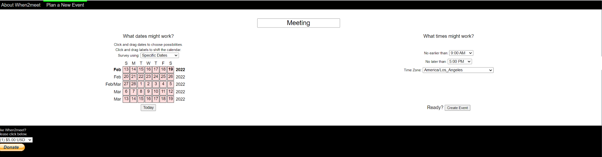
Research Plan
Goal
Understand the parts of when2meet (and other scheduling applications) the user likes and the points of frustration.
This research will help:
- Many working adults and students rely on this application
- Uncover UI issues
- Increase usability in the application
- Understand features that will evolve the application
Objectives
- Understand what works and doesn’t on when2meet as many working adults and students heavily use this application
- Uncover what when2meet users love and miss about their scheduling experience
- Learn why when2meet users have stopped using this application or why they think the application draws people away
- Identify problems or barriers across the end to end when2meet experience and what improvements can be made
Notes:
More on defining research objectives here

Slide 4
Participant Overview
Interview Participants
User groups: Working Adults & Students
1-1 interviews
HIGH ACTIVITY > Weekly usage of when2meet
A
2
LOW ACTIVITY < Every few weeks usage of when2meet
B
1
C
NEW USER = Have heard of it or has never used when2meet
2
5 participants

Slide 5
WHAT I LEARNED
Research Findings

Slide 6
Summary
Key findings
THEME
INSIGHT
OPPORTUNITIES
Visual UI & Interaction Improvement
Many users voiced their lack of appeal in when2meet as the look of the page had many technical and visual issues. This ranged from the typography (fonts and images are too small), aesthetics negatively affecting the usability of the site, and more.
Redesigning many visualization components while keeping the framework of the original site
Lack of “trust” from the users due to aesthetics
Along with the aesthetics came a concern of trust in when2meet. The aesthetics of the application looked “spammy” and “suspicious” to many users, leading to wary users. The lack of trust can ultimately lead to a decrease in users as the unprofessional look can deter users from using the site again.
After breaking down different audiences, when2meet can change the page based on profession
Issues in lack of reach for when2meet
Users have voiced that they started using this application through word of mouth (someone prescribed it to them). With that, many users say that they have never heard about it before and therefore can be a issue of lack of marketing.
Figure out the target audience and market the specific features to increase users

Slide 7
WHAT I LEARNED
Positive Findings

Slide 8
Positive Findings
General Meeting App Findings
Scheduling platforms have auto settings including a built in video system
Big organizations tend to use Microsoft Teams due to it automatically connecting to the video system
Seamlessness of Zoom
Positive Findings
Apps used: Zoom, Google Calendar(Google Meets), Microsoft Teams/Outlook, Slack, Email, House Party, GoToMeeting
when2meet Findings
Simple and easy to use, yet a good concept idea
Helpful in today's remote work environment where team members are located everywhere
Saves time on communication errors and located in one place
Top 3 highlighted
Observation:
Working adults use Zoom and Microsoft Teams
Students use when2meet and Google Calendar
when2meet Aesthetic Findings
Tools and overall look is simple
Good color pallet where you can see a clear association between each color meaning
“It does what it means to do which is honestly what any type of feature should really focus on”

Slide 9
WHAT I LEARNED
Negative Findings

Slide 10
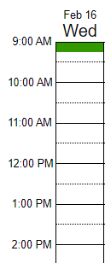
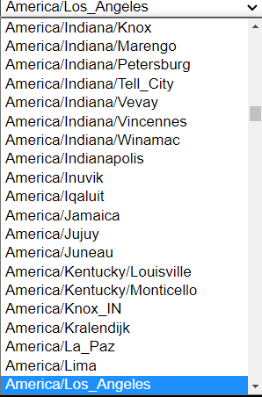
General Meeting App Findings
Most apps require accounts to use scheduling applications
Too many settings to sift through
Connection and link validation issues
Negative Findings
Negative Findings
when2meet Findings
Functions are not clear & confusing
Oftentimes users will be mindlessly clicking to work functions
Accuracy in dragging is important since the increments on the side show 30 minutes, however you can input in 15 minute increments
Too many options to sort through time zones
Observation:
Many issues regarding the visualization of the site:
Interaction of features
Ads take away from experience
Typography
Site lacks professional feeling to site
Difficult to trust the site
when2meet Aesthetic Findings
Everything is too small and difficult to see
All fonts & images
Availability of different team members
Not visually appealing (too bland)
Site looks unprofessional and spammy
Too many Ads
“I mostly have a lot of ads on it so I'm just like okay there's one giant ad right there and then it's very blocky and I think today a lot of features layout of things isn't really blocky anymore. It's more rounded it's more like modernized”

Slide 11
WHAT I LEARNED
Neutral Findings

Slide 12
Neutral Findings
General Meeting App Findings
Don’t have any feelings towards scheduling apps
They don’t really use scheduling apps
Use it for work and school, but nothing else
Neutral Findings
Observation:
Generally, users use scheduling apps and when2meet for required meetings and projects
when2meet is simple and bland, making many users have no opinion on it
First time users were able to set up a meeting, but was not incredibly impressed with the features
when2meet Findings
Used the application more in big groups, but only a couple times
Haven’t looked back on it since college
No real impressions on the look
when2meet Aesthetic Findings
when2meet has a mission and does the bare minimum
It’s not challenging to maneuver, but it could look nicer
“It gets the job done”

Slide 13
Next Steps: Design

Slide 14
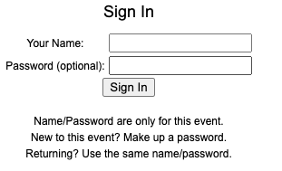
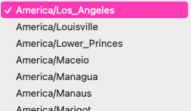
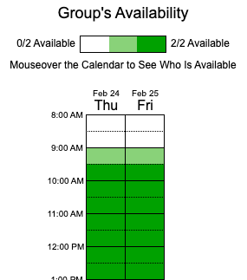
Recommendations
01
Focus on the feature UI interaction - figure out what features need to be scratched, adjusted, or added. For example, start working on the login function, decreasing the time-zone availabilities, create a calendar invite option, connect to a video meeting application, and more.
02
See how to keep site simple look, but professional - main issue voiced was the spammy look so there needs to be a way to keep the site simple, yet aesthetically interesting enough for the user to share
03
Improve the visual UI- fix the typography and color combinations to make it more usable on a bigger screen (especially since it is a web based application and not an app)

Slide 15
Thank you!

